Slide 1
M7L2 Task3 Game

Slide 2
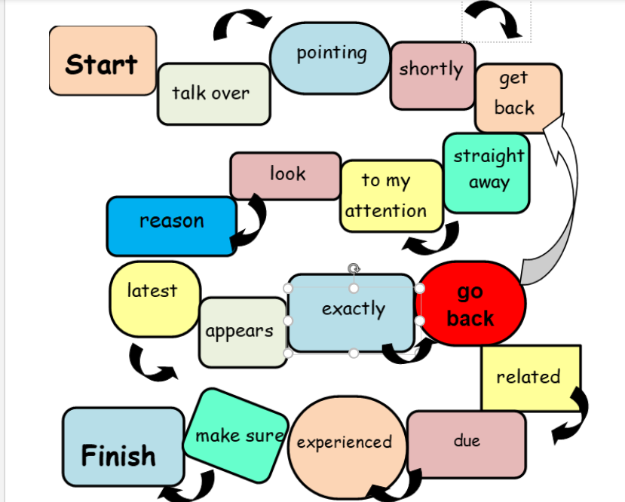
Play a board game with a partner. Each turn, toss a coin here (heads = one step forward, tails= two steps forward) and say a sentence containing the word /phrase in the field.
Room 1

Slide 3
Play a board game with a partner. Each turn, toss a coin here (heads = one step forward, tails= two steps forward) and say a sentence containing the word /phrase in the field.
Room 2

Slide 4
Play a board game with a partner. Each turn, toss a coin here (heads = one step forward, tails= two steps forward) and say a sentence containing the word /phrase in the field.
Room 3

Slide 5
Play a board game with a partner. Each turn, toss a coin here (heads = one step forward, tails= two steps forward) and say a sentence containing the word /phrase in the field.
Room 4

